Slide 1
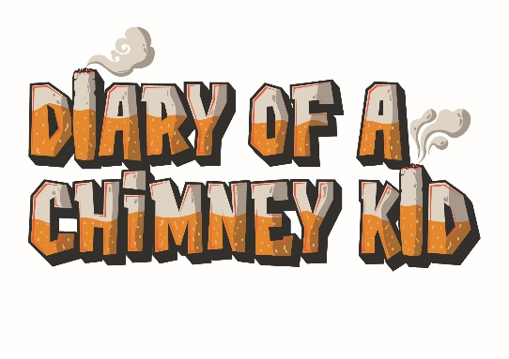
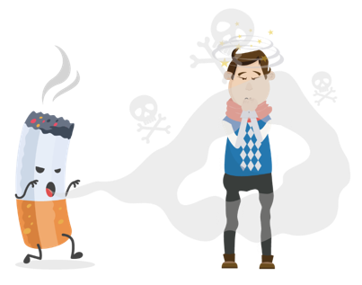

Chimney Kid Quiz: Answers
(KS3&4)
Suggested duration: 20 to 30 minutes

Slide 2
Answers:
More and more young people in Hull are choosing not to smoke.
Your first Car.
Any of the below answers count as a point:
  Always use a suitable ashtray and make sure it can’t be knocked over
  Never smoke in bed
  Do not empty into a bin at night
  Never leave a lit cigarette lying around
6 million
Carbon monoxide, nicotine and tar
70%
30%
18 years of age

Slide 3
150 cigarettes
ReFresh
1964
£3,360
40%
The smell
Between 4,000 and 7,000 chemicals
Professional help
Over 80% of people in the UK DON’T smoke
A deposit for a house
2,700 deaths
10 Seconds

Slide 4


Diary of a Chimney Kid is a resource that offers lots of information, facts, and advice on smoking. We share stories from real people in Hull to show how smoking affects all aspects of people’s lives, whether they smoke themselves or not.
Use www.chimneykid.co.uk or follow us by searching ‘Diary of a Chimney Kid’ on Instagram & YouTube.
If you or a friend needs help to quit smoking, you can access the children and
young people’s support service ‘Refresh’ anonymously via the details below.
Or access the ‘Quitting’ section on the Chimney Kid website for further
information.
T: 01482 331059 E: refresh@hullcc.gov.uk

