Slide 1
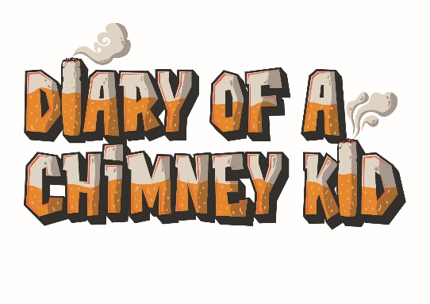
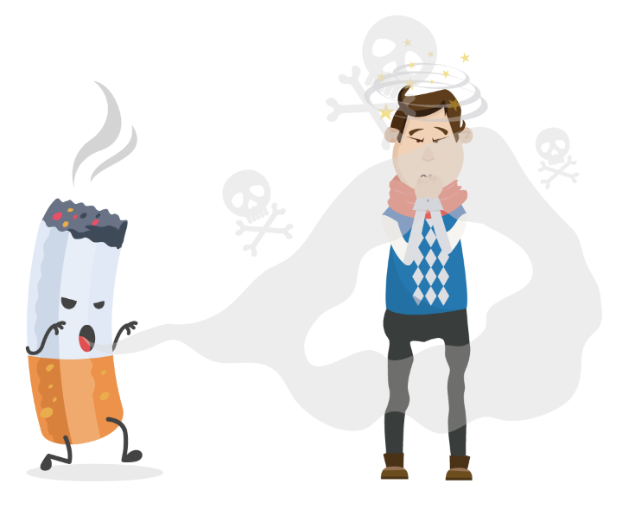

Chimney Kid Quiz: Questions
(KS3&4)
Suggested duration: 20 to 30 minutes

Slide 2

What do you do?
Go to onto www.chimneykid.co.uk
Go through and answer the questions on the next slides.
Use the website to correctly answer as many as you can.
Good luck!

Slide 3
Questions:
According to the video on the home page what is the truth? Hint: watch the video!
What could someone buy if they stopped smoking for 6 months and normally smoked 4 packets of cigarettes a week? Hint: the average cost of a packet of cigarettes is £10. Use the spend calculator to see what you could buy!
What things can be done to prevent fires if you or somebody else in your home smokes in the house? Hint: find the right page from “More about smoking”
Globally how many trees are cut down every year to make way for tobacco production?
What are 3 main nasty substances in a cigarette?
What percentage of smokers say they want to quit smoking for good?

Slide 4
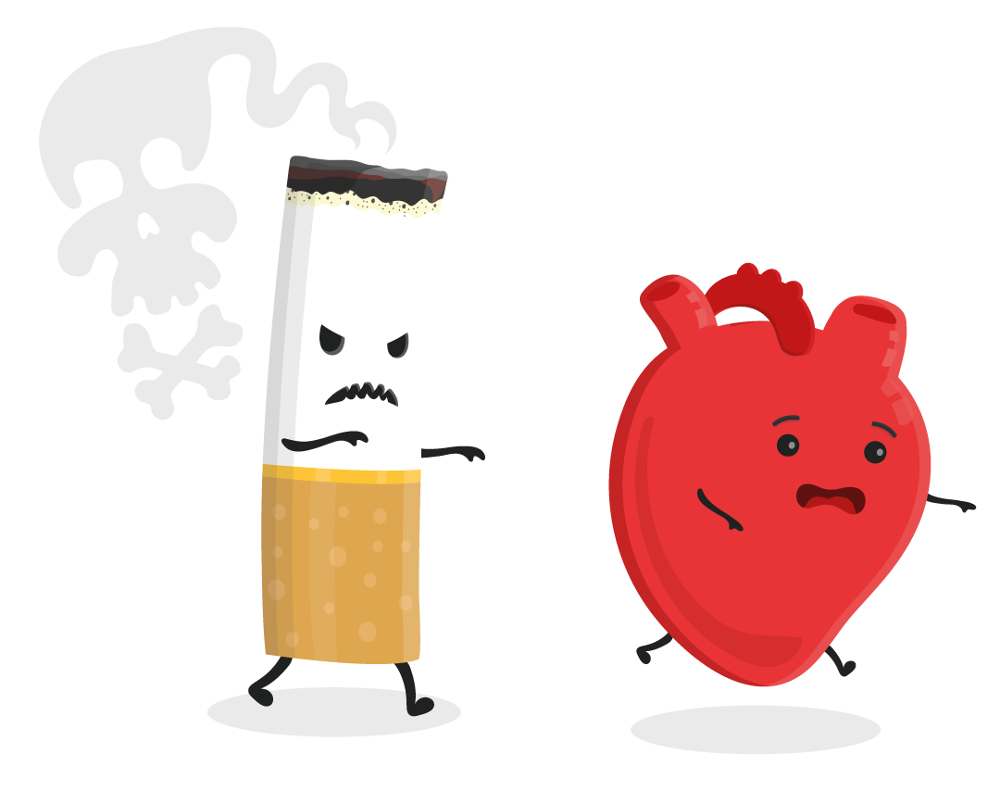
Within 10 minutes of inhaling smoke, how much harder is the heart having to work? (as a percentage)
What is the legal age to buy an e-cigarette or vape?
Over a year, children living in a household with two or more smokers can inhale the same amount of nicotine as smoking how many cigarettes themselves?
What is the name of the young people’s Stop Smoking Service in Hull?
In what year were TV adverts promoting cigarettes banned?
A person who smokes 20 cigarettes every day will spend around £70 a week on cigarettes, how much would they spend over a year? Hint: this is a maths question!
What percentage of street litter is smoking related?

Slide 5
What is the first thing you will notice about a smoker?
How many chemicals are in cigarette smoke?
What are you four times more likely to quit smoking with?
What is the Friday Fact on February 7th? Hint: find the right month in the diary
If you smoked 5 packets of cigarettes per week and you stopped smoking for 10 years, what could you buy?
How many deaths does second-hand smoke cause every year in 20 – 63 year olds?
Nicotine starts to affect the brain within how many seconds of inhaling cigarette smoke?
How did you do?! 20

Slide 6


Diary of a Chimney Kid is a resource that offers lots of information, facts, and advice on smoking. We share stories from real people in Hull to show how smoking affects all aspects of people’s lives, whether they smoke themselves or not.
Use www.chimneykid.co.uk or follow us by searching ‘Diary of a Chimney Kid’ on Instagram & YouTube.
If you or a friend needs help to quit smoking, you can access the children and
young people’s support service ‘Refresh’ anonymously via the details below.
Or access the ‘Quitting’ section on the Chimney Kid website for further
information.
T: 01482 331059 E: refresh@hullcc.gov.uk

