Slide 1
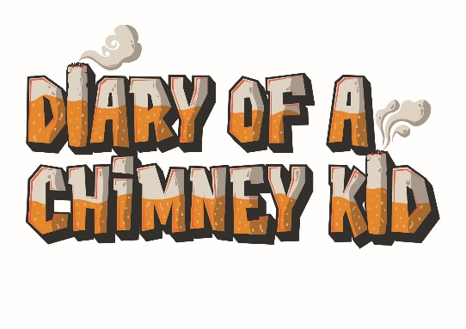
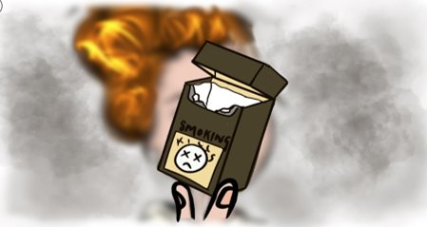

Smokey Film Quiz: Answers
(KS3&4)
Suggested duration: 20 to 30 minutes

Slide 2

Smokey | Fire:
Emoji pillow
Girl on Fire – Alicia Keys
Throws a glass of water in Smokey’s face
The truth is that more people die in fires caused by smoking than any other cause
Smokey | Pets:
Cigarettes
Orange
Red handkerchief
The truth is that living in a house with a smoker puts pets at greater risk of many health problems

Slide 3

Smokey | Romance:
Kissing
Mints
Because he smelt of cigarette smoke
The truth is that most people don’t like the smell of cigarette smoke
Smokey | Smell:
“Have you just been out for a bit of fresh air?’
Because he smelt of cigarette smoke
Grey
The truth is that the smell of stale cigarette smoke sticks around on your hair, clothes and breath

Slide 4
Smokey | Social:
Socialising with his friends
No
Smoking
The truth is that more and more young people in Hull are choosing not to smoke
End
How did you do?!

Slide 5


Diary of a Chimney Kid is a resource that offers lots of information, facts, and advice on smoking. We share stories from real people in Hull to show how smoking affects all aspects of people’s lives, whether they smoke themselves or not.
Use www.chimneykid.co.uk or follow us by searching ‘Diary of a Chimney Kid’ on Instagram & YouTube.
If you or a friend needs help to quit smoking, you can access the children and
young people’s support service ‘Refresh’ anonymously via the details below.
Or access the ‘Quitting’ section on the Chimney Kid website for further
information.
T: 01482 331059 E: refresh@hullcc.gov.uk

