Slide 1



Smoking Poster Design
(KS3)
Suggested duration: 50 to 60 minutes

Slide 2
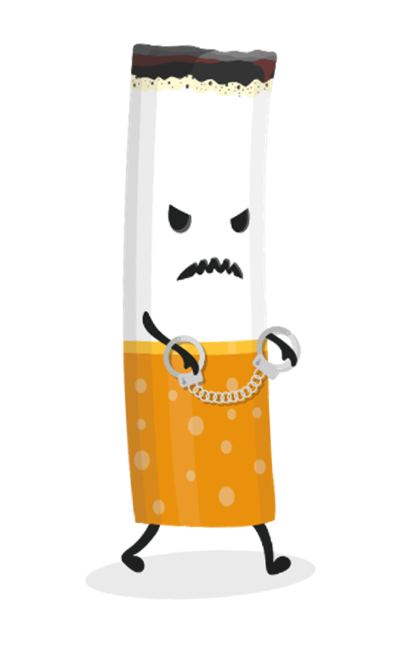
Let’s get creative!
First, think of a title for your poster, something that will grab people’s attention. Be imaginative and think of what would grab your attention.
Then, decide what the poster should include and how you are going to present your message. You can use the Chimney Kid website to help you decide on the key message. For example, will your message be that smoking is bad for your health? The cost of smoking? Environmental issues caused by smoking? Top tip: there are lots of facts you can use on the website under the ‘Diary’ section!
Next up, it’s time to get creative! Whether you’re designing your poster on a computer or by hand, try and make it bright and eye catching. You can add any images or colours that you think will work well for your message. Top tip: think of the things you like to see and what catches your eye. After all, your poster is aimed at other people your age!

Slide 3

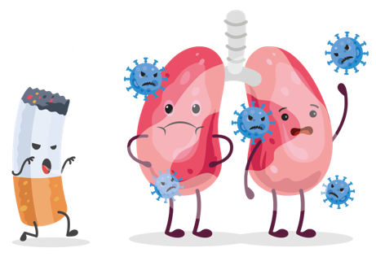
Share your design!
Once you have completed your poster, get into pairs and show each other your poster designs. Talk about what you think works well for each poster. Ask each other questions about the designs and the decisions you have made and see if you can find ways to make them even better!
If you’re working on your own, show your poster to a teacher or parent and discuss your design with them!
Well done on completing your poster!

Slide 4


Diary of a Chimney Kid is a resource that offers lots of information, facts, and advice on smoking. We share stories from real people in Hull to show how smoking affects all aspects of people’s lives, whether they smoke themselves or not.
Use www.chimneykid.co.uk or follow us by searching ‘Diary of a Chimney Kid’ on Instagram & YouTube.
If you or a friend needs help to quit smoking, you can access the children and
young people’s support service ‘Refresh’ anonymously via the details below.
Or access the ‘Quitting’ section on the Chimney Kid website for further
information.
T: 01482 331059 E: refresh@hullcc.gov.uk

