Slide 1
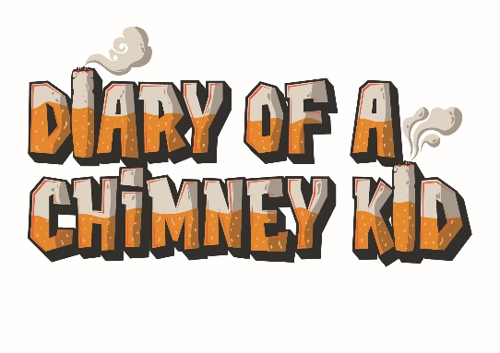
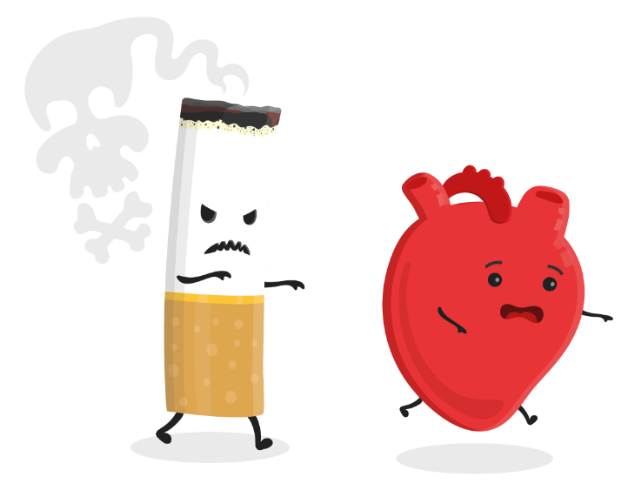

Smoking Prevention Advert
(KS4)

Slide 2

What to do?
Your task is to create an advert to prevent young people between the ages of 11-16 from starting smoking.
Once you have created your advert, present your idea to your class, group or helper. Invite them to ask questions about the decisions you have made during the thinking and design process.

Slide 3
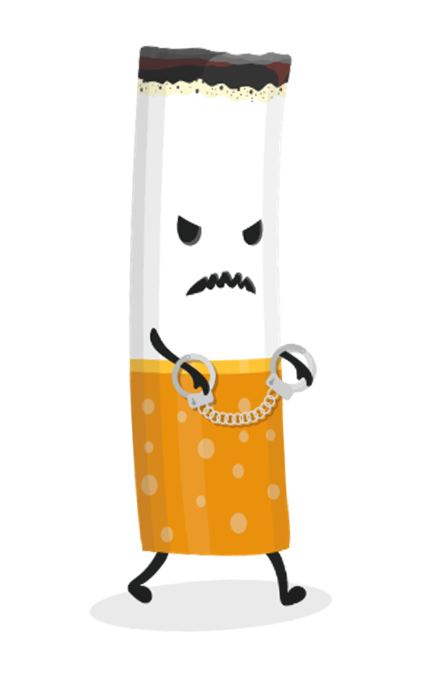
Let’s get started and create your advert:
You can get into groups to create an advert together (4-5 people) or you can do this on your own.
Firstly, decide where the advert should be shown. Will you be creating a TV advert, radio advert, poster, leaflet, social media post? Consider and discuss why you think your chosen option would reach your target audience (11-16 year olds). - Remember, you may be asked this in the Q&A at the end!
What is the key message in your ad and why would this be important to the audience? You can use the Chimney Kid website to find facts and information. For example, are you going to focus on the effects smoking has on the body? The cost? Environmental issues?
What is your call to action? What would you like people to do when they see your advert? Should there be contact details for support services or advice on who they should turn to for help?
Get creative! You will need to have a well-considered advert ready to present to others such as a poster design, a storyboard to represent your TV advert or a nicely presented script for audio materials.
Tips on next slide!

Slide 4
Other things to consider:
What sort of tone will your advert have? Funny, serious, friendly?
If you are including contact details, make sure you guide people to the correct website/number on your advert.
Try to think of the things you like to see and what might catch your attention, after all, you are the target age group!
Practise presenting before you present to others so that you are well prepared.

Slide 5
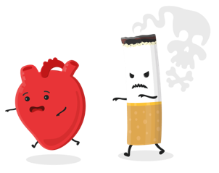
Now it is time to present your ideas!
Present your advert idea and explain why you think it will be effective at preventing young people from taking up smoking.
Your presentation should be no longer than 5 minutes long followed by a 5 minute Q&A session with questions put forward by whoever you are presenting to.
Questions could be things like; Where will the advert be? Why did you pick a funny idea over a serious idea? You should consider these too!
If you’re working independently, you could present your idea to a teacher, parent or friend to discuss your concept and find ways to make it even better!

Slide 6


Diary of a Chimney Kid is a resource that offers lots of information, facts, and advice on smoking. We share stories from real people in Hull to show how smoking affects all aspects of people’s lives, whether they smoke themselves or not.
Use www.chimneykid.co.uk or follow us by searching ‘Diary of a Chimney Kid’ on Instagram & YouTube.
If you or a friend needs help to quit smoking, you can access the children and
young people’s support service ‘Refresh’ anonymously via the details below.
Or access the ‘Quitting’ section on the Chimney Kid website for further
information.
T: 01482 331059 E: refresh@hullcc.gov.uk

