Slide 1
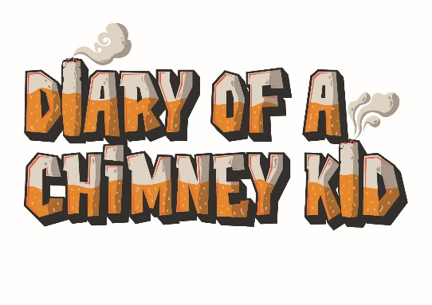
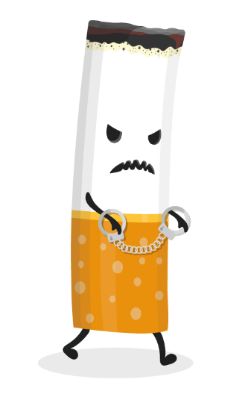

Smoking Spider Diagram
(Key Stage 3)
Suggested Duration: 20 to 30 minutes

Slide 2

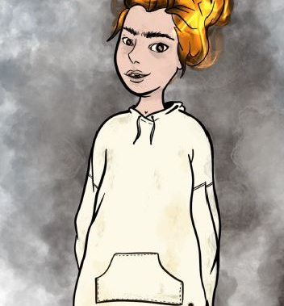
This is Smokey. Smokey represents a cigarette. If you have seen our Smokey films, you will know that Smokey isn’t a very nice person at all!
(You can find the Smokey videos on the Diary of a Chimney Kid YouTube channel to watch.)
What to do?
Your task is to write down one (or more) way that smoking can affect each of the 6 points on the next slide.
For example; How someone looks: They will get stained yellow teeth!
Let's go...

Slide 3
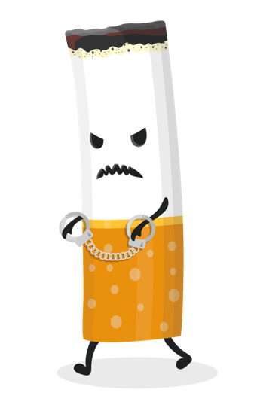
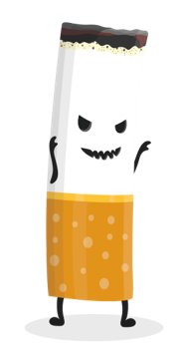
Health
Money
How someone looks
Pets
Environment
Relationships

Slide 4


Diary of a Chimney Kid is a resource that offers lots of information, facts, and advice on smoking. We share stories from real people in Hull to show how smoking affects all aspects of people’s lives, whether they smoke themselves or not.
Use www.chimneykid.co.uk or follow us by searching ‘Diary of a Chimney Kid’ on Instagram & YouTube.
If you or a friend needs help to quit smoking, you can access the children and
young people’s support service ‘Refresh’ anonymously via the details below.
Or access the ‘Quitting’ section on the Chimney Kid website for further
information.
T: 01482 331059 E: refresh@hullcc.gov.uk

