Slide 1
Vaping: The Facts
Enabling young people to make informed decisions
A presentation to support teachers and safeguarding leads in developing their knowledge on vaping and CYP.
This will also support discussions and debate in the classroom
Notes:
This presentation can be delivered as a presentation or used for individual learning.

Slide 2
Hull and East Riding of Yorkshire Vaping Survey Nov/Dec 2022
Regular vaping among young people increased with age from 0.4% of 11 year olds to 18.6% of 17 year olds
The rate of those who had ever tried vaping was 26.5%
13.6% of young people who had never smoked had tried an e-cigarette
While this data is a cause for concern and needs monitoring, 72.4% said they don’t vape and never will and only 2.9% of non-smokers vape regularly
Notes:
5,319 11 to 17 year olds from Hull and the East Riding of Yorkshire (ERY) took part in the survey 5,074
During 2022 several calls were received by Hull City Council, Public Health and Public Protection requesting information and advice on the use of vapes by children and young people and to report underage sales of vaping products. SmokeFree Hull, our local Stop Smoking Service also received calls requesting support to quit vaping. At the same time there were several articles in the press raising concerns that vapes are a gateway into smoking. The evidence base around attitudes toward vaping amongst young people is slim, although Action on Smoking and Health recently conducting a survey but with lower respondents. To understand these attitudes better and inform our system response a local survey was conducted.

Slide 3
Hull and East Riding of Yorkshire Vaping Survey Nov/Dec 2022
A young person’s decision to smoke or vape increased if an adult in the home smoked or vaped
Main source of advertising is shops, TikTok and Instagram
Most popular reasons to vape:
  ‘l like the different flavours’
  ‘I like the taste’
  ‘Vapes are easier to get than cigarettes’
  ‘Vapes are cheaper than smoking’
Disposable vapes are the most used vape among young people

Slide 4
What is vaping?
Vaping is the use of an electronic device to inhale vapour derived from a heated liquid.
The main ingredients are vegetable glycerine and propylene glycol, but most e-liquids also contain nicotine, which must be no more than 2% or 20 mg per ml, as well as small amounts of flavourings.

Slide 5
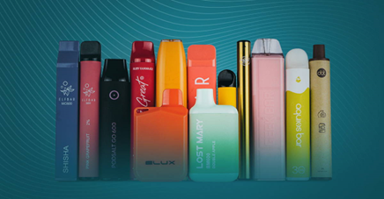

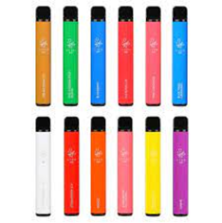
What is a vape device?
There are a variety of vape devices (which are also known as e-cigarettes). The names and type of devices keep changing and new ones come on to the market frequently. Below are the main types of vapes currently available:
vape bars shaped like a highlighter pen (usually single use and disposable but sometimes rechargeable and refillable with e-liquid capsules)
compact pod devices shaped like a flash drive or pebble (either disposable, or rechargeable and refillable with e-liquid capsules)
vape pens with a tank you fill with e-liquid, and a replaceable coil and rechargeable battery
"cigalikes" designed to look like a cigarette (either disposable, or rechargeable and refillable with e-liquid capsules)
customisable devices with variable power (these are more difficult to use and need more maintenance)
Vaping to quit smoking - Better Health - NHS (www.nhs.uk)
Notes:
Also known as e-cigarettes
The names and type of devices keep changing and new ones come onto the market frequently

Slide 6
How do nicotine vapes help smokers quit?
Smoking delivers nicotine rapidly to the brain, which makes it highly addictive.
Cravings for nicotine among those addicted can make people feel stressed, restless, irritable and unable to concentrate.
Like nicotine patches and gum, vapes containing nicotine are a useful aid to quitting as they deal with the cravings smokers get when they try to stop.
Nicotine vapes help smokers quit by replacing some of the nicotine they used to get from cigarettes and also by mimicking the hand-to-mouth action of smoking.

Slide 7
How do nicotine vapes help smokers quit?
Nicotine replacement therapy such as gum and patches are licensed by the Medicines and Healthcare products Regulatory Agency for smoking cessation, not just by adults but also by children from age 12 upwards.
Nicotine vapes are not yet licensed as medicines but are proven effective and have become the most popular quitting aid for smokers in recent years.
However, vapes are not for recommended non-smokers, particularly children.

Slide 8
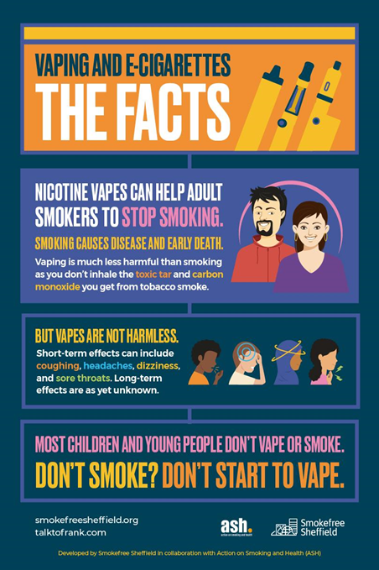
What are the concerns with vaping and children and young people?
Most children and young people don’t vape or smoke.
However in 2022 the number of 11–17-year-olds in the UK using vapes rose to 7% compared to 4% in 2020.
Regular vaping is mainly confined to children who currently smoke or have done in the past.
The increase in youth vaping has coincided with the arrival on the UK market of a new category of cheap and attractive disposable vapes that have proven particularly popular with children and young people and have been promoted extensively on social media.

Slide 9
Nicotine vapes and dependency in Children and Young People
23% of current vapers in the local survey said they were addicted to vapes
43% or those who vape occasionally and 77.3% of those who vape regularly reported they craved a vape or felt irritable if they hadn’t vaped for a while

Slide 10
Smoking vs vaping
Smoking is much more harmful than vaping. Tobacco smoke contains 7,000 chemicals including carbon monoxide and tar, and a sticky soup of around 250 toxic chemicals (more than a quarter of which are known to be carcinogens), causing disease, disability, and early death.

Slide 11
Vapes are not harmless
The levels of exposure to cancer causing and other toxicants are extremely low in people who vape compared with those who smoke but there is still some exposure
Short-term effects can include coughing, headaches, dizziness and sore throats.
The long-term effects are, as yet, unknown.
Our advice to children and young people is:
DON’T SMOKE? DON’T START TO VAPE

Slide 12
Question!
Why do you think children try vaping?

Slide 13
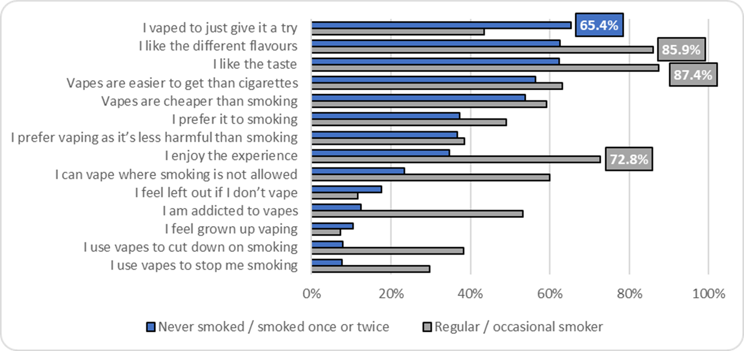
Reasons for vaping by smoking status
Hull & ERY Vaping Survey 2022

Slide 14
Question!
Where do you think children and young people who vape get them?
And what can we do about this?

Slide 15
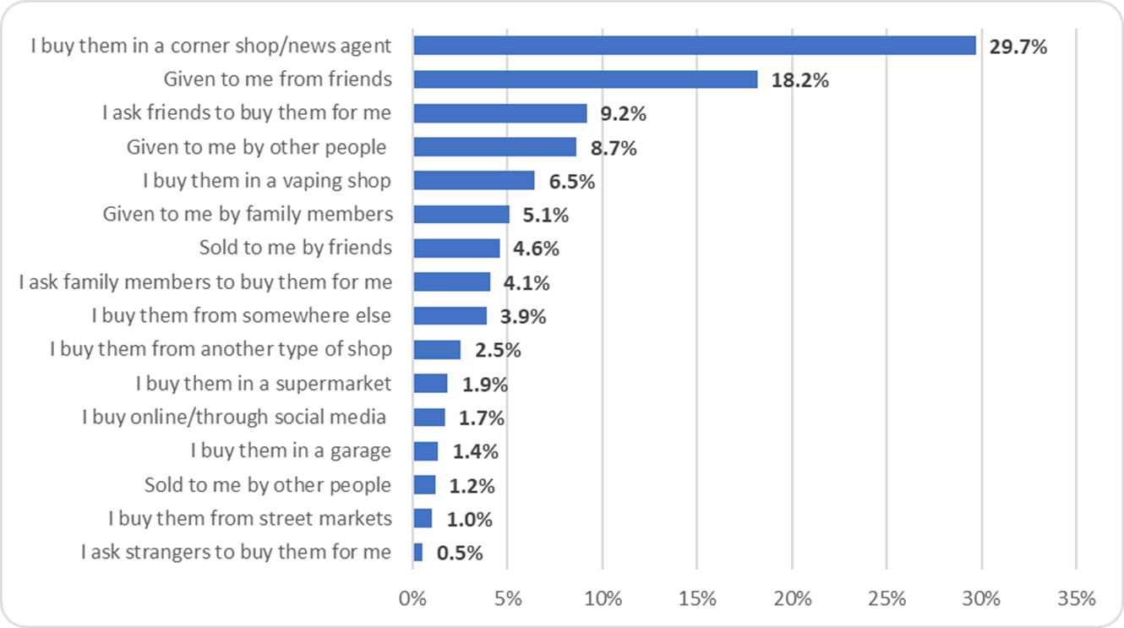
For 11-17-yr-olds, shops are still most common route of purchase for tobacco and vapes Hull & ERY Vaping Survey 2022

Slide 16
Question!
Where is vaping being promoted online and what can we do about this?

Slide 17
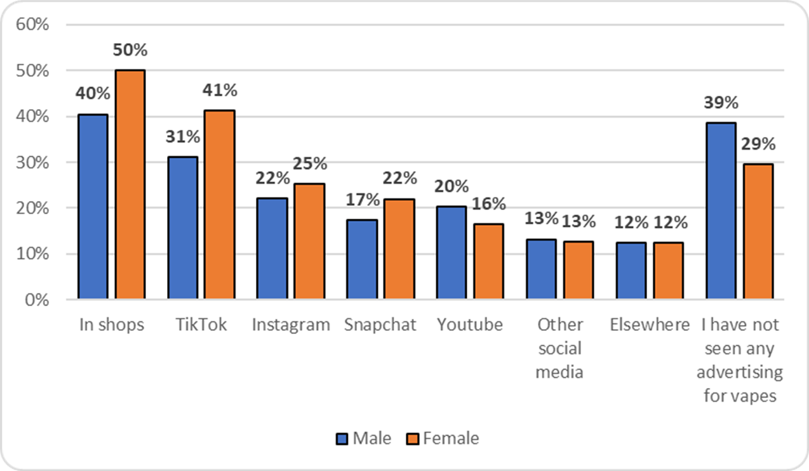
Where are 11 – 17 year olds seeing advertising?
Hull & ERY Vaping Survey 2022

Slide 18
The law and vaping
Vapes and vaping products containing nicotine, like tobacco, are age restricted. It’s illegal to sell them to under 18s, and for adults to buy them on their behalf.
Those who knowingly sell vapes to under 18s don’t care who they sell to and they are just interested in making money.
If you know of anyone who does sell vapes, or tobacco illegally, you can report them to trading standards https://www.hull.gov.uk/crime-and-safety/consumer-advice/illegal-sales-young-people

Slide 19
Regulation of vapes to protect health
In the UK we have tight regulations around the strength of nicotine allowed in vapes and they must carry health warnings on the packaging E-cigarettes: regulations for consumer products - GOV.UK (www.gov.uk).
Vaping products containing nicotine are regulated by the Medicines and Healthcare products Regulatory Agency (MHRA), which provides advice for consumers.
They also must not contain vitamins, stimulants such as caffeine or taurine, colourings and chemicals which are carcinogenic, mutagenic
and reprotoxic in their unburnt form

Slide 20
Regulation of vapes to protect health
Sales to those under 18 are illegal, but to be legally sold in the UK nicotine containing e-cigarettes must also:
  Contain 20 mg/ml or less of nicotine (equivalent to 2% or less)
  Carry the health warning ‘This product contains nicotine which is a highly addictive substance”.
  Be notified to the MHRA and listed on its website.
  In addition there are a number of ingredients which are prohibited in nicotine-containing e-liquid, including vitamins, stimulants such as caffeine or taurine, colourings and chemicals which are carcinogenic, mutagenic and reprotoxic in their unburnt form.

Slide 21
Advertising
Advertising of all tobacco products is illegal.
Advertising of nicotine-containing vaping products is prohibited on broadcast media (TV and radio); and in newspapers, magazines and periodicals; online media and some other forms of electronic media (this includes social media).
If you see advertising for vapes that you feel is trying to encourage children and young people to try vaping, you can report it to the Advertising Standards Authority www.asa.org.uk.
Non-commercial public health campaigns promoting vaping as an alternative to smoking are permitted.

Slide 22
How much nicotine is there in vapes compared to cigarettes?
Disposable vapes DO NOT contain as much or more nicotine as a packet of 20 cigarettes.
Comparing like with like, a UK standard 2 ml disposable vape contains 40 mg of nicotine; an average pack of 20 cigarettes contains 250 mg of nicotine, which is more than six times as much.
For both smoking and vaping, a small proportion of the nicotine content is absorbed by the user and depends largely on how a cigarette or vape is used, rather than what it contains.

Slide 23
How much nicotine is there in vapes compared to cigarettes?
A packet of cigarettes takes between 160 and 320 puffs to smoke.
Popular disposable vapes, such as Elf Bar and Geek Bar, are said to contain around 600 puffs, but puffs on vapes ARE NOT equivalent to puffs on cigarette.

Slide 24
Diacetyl and Popcorn Lung
You may have heard of ‘popcorn lung’, a serious but rare respiratory disease so-called because it was found in popcorn factory workers, who had been exposed to high levels of exposure to diacetyl, which was used to give popcorn a buttery flavour.
Some vapes were found to contain diacetyl but in very small quantities, not the large quantities associated with ‘popcorn lung’. However, as a safety precaution it has been banned from vapes in the UK as are other ingredients that pose a risk to human health.

Slide 25
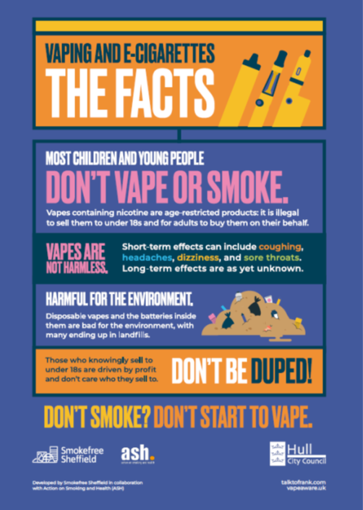
How does vaping harm the environment ?
Single-use vapes contain batteries and difficult to recycle plastics.
Approximately 1.3 million disposable vapes are thrown away every week in the UK: enough to cover 22 football pitches.
These break down in landfills causing dangerous chemicals to pollute the soil and water.
These chemicals can cause harm to humans, animals and the environment.

Slide 26
What about the impact of tobacco on the environment?
Tobacco growing, curing and manufacturing pollutes the environment, causes soil degradation, biodiversity losses, and deforestation.
Tobacco cigarettes are the most littered item and the toxic chemicals they contain pollute our pavements, parks, soil, rivers, and the sea with devastating consequences.

Slide 27
Impact of tobacco on the environment
Globally the tobacco industry manufactures the equivalent of six trillion cigarettes each year, using 5.3 million hectares of land.
Every year tobacco costs more than 8 million human lives, and 600 million trees, and 4.5 trillion cigarette filters pollute our pavements, parks, soil, rivers, beaches and oceans.
Tobacco produces 25 megatons of solid waste, 55 megatons of wastewater, almost 84 megatons of CO₂ emissions to climate change – approximately 0.2% of the global total.

Slide 28
Our advice
Vapes are helpful quit aids to support smokers to stop
Our advice to children and young people and non smokers is:
Don’t smoke? Don’t start to vape

Slide 29
Debate and discussion
Key questions:
What do they think about smoking…?
  …and what do they think about vaping…?
  …what is the difference?
Do they know people who smoke or vape?
Why do they think people smoke or vape?

Slide 30
Debate and discussion
Key questions:
Discuss the different reasons why children may smoke or vape – give examples such as wanting to fit in, curiosity, stress. Talk through effective ways to respond if they ever feel pressured to try either and practise responding together. More information can be found here to support these conversations - Feeling pressured to take drugs? Here are 10 ways to deal with it | FRANK (talktofrank.com).
Explain the facts.
Discuss why nicotine vapes are not for non-smokers and children but
are an effective quitting aid for adult smokers.
For more information about smoking and vaping visit: https://chimneykid.co.uk/

Slide 31
Debate and discussion
If a child confides that they are a smoker or a vaper try to understand why they are smoking or vaping by asking questions like “What do you enjoy about smoking or vaping?” Or “How does smoking or vaping make you feel?”. Understanding this might help you to understand their needs and discuss other ways to meet their needs.
Make a referral, where appropriate, to the school nurse, pastoral lead, safeguarding lead who can then seek support re: vaping or stopping smoking
Additionally children and young people can be directed to Talk to FRANK telephone support
0300 123 6600 for confidential advice
Provide information on the school smoking and vaping policies - children should not be
excluded from school for vaping or smoking, unless it is associated with other disruptive behaviour which justifies this.
Children and Young People 12 years and over can be referred to SmokeFree Hull for support to quit smoking. Call 01482 977617 or go on line to SmokeFree Hull - stop smoking service (changegrowlive.org)
For support to quit vaping call ReFresh on 01482 331059 or visit https://www.refreshhull.org.uk

Slide 32
Debate and discussion
If a child confides that they are a smoker or a vaper try to understand why they are smoking or vaping by asking questions like “What do you enjoy about smoking or vaping?” Or “How does smoking or vaping make you feel?”. Understanding this might help you to understand their needs and discuss other ways to meet their needs.
Make a referral, where appropriate, to the school nurse, pastoral lead, safeguarding lead who can then seek support re: vaping or stopping smoking
Additionally children and young people can be directed to Talk to FRANK telephone support
0300 123 6600 for confidential advice
Provide information on the school smoking and vaping policies - children should not be
excluded from school for vaping or smoking, unless it is associated with other disruptive behaviour which justifies this.
Children and Young People 12 years and over can be referred to SmokeFree Hull for support to quit smoking. Call 01482 977617 or go on line to SmokeFree Hull - stop smoking service (changegrowlive.org)
For support to quit vaping call ReFresh on 01482 331059 or visit https://www.refreshhull.org.uk

Slide 33
Further reading and helpful info
www.changegrowlive.org/smoke-free-hull/home
www.refreshhull.org.uk
ASH-brief-for-local-authorities-on-youth-vaping.pdf
www.nhs.uk/better-health/quit-smoking/vaping-to-quit-smoking/
https://ash.org.uk/uploads/Use-of-e-cigarettes-among-young-people-in-Great-Britain-2022.pdf
Vapes | FRANK (talktofrank.com)
https://ash.org.uk/uploads/ASH-guidance-for-school-vaping-policies.pdf
https://www.gov.uk/government/publications/nicotine-vaping-in-england-2022-evidence-update

